Slide 1
Steven is Away!!
Starting tomorrow, Thu, 29 March 2012…
Will only return on Tue, 03 Apr 2012…
ICPC Training @ IIUM, KL
So,
  Weekly feedbacks on HW Ch5 (3 students) + Ch6 book review will be delayed…
  Class statistics will be likely frozen until next week
  (maybe including tonight’s mini contest 9 results)
  Will be slow in responding emails queries…
CS3233 - Competitive Programming,
Steven Halim, SoC, NUS

Slide 2
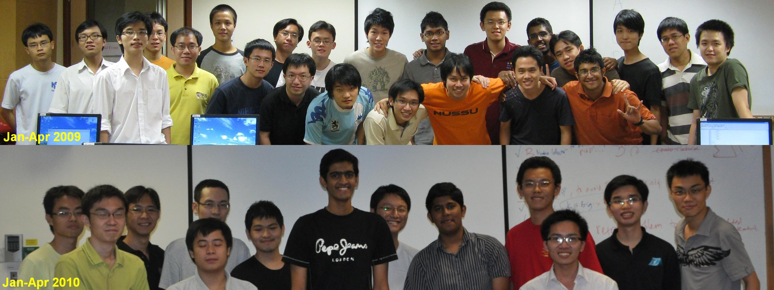
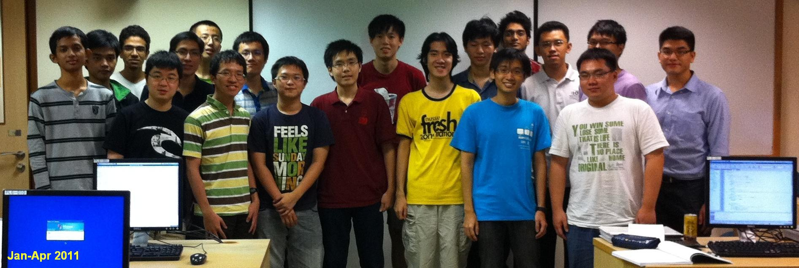
We will take Class Photos Next Week Important for documentation/promotional purpose ☺
CS3233 - Competitive Programming,
Steven Halim, SoC, NUS
Jan-Apr 2011

Slide 3
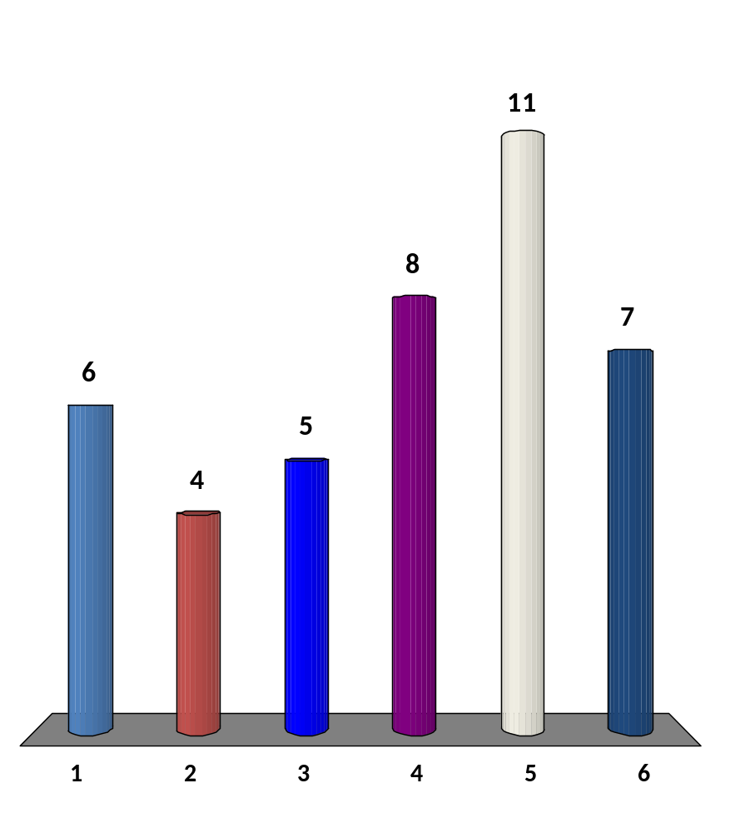
I observe ~90% of CS3233 students do not have Chapter 7 Diversity yet
(you can click up to 6 options)
I do not like geometry problems
I am afraid of floating point or precision errors/WA
I forgot many basic geometry formulas
I do not know that many geometry algorithms
I simply do not have time to tackle Chapter 7 yet
Other reasons
17 of 120
CS3233 - Competitive Programming,
Steven Halim, SoC, NUS

Slide 4
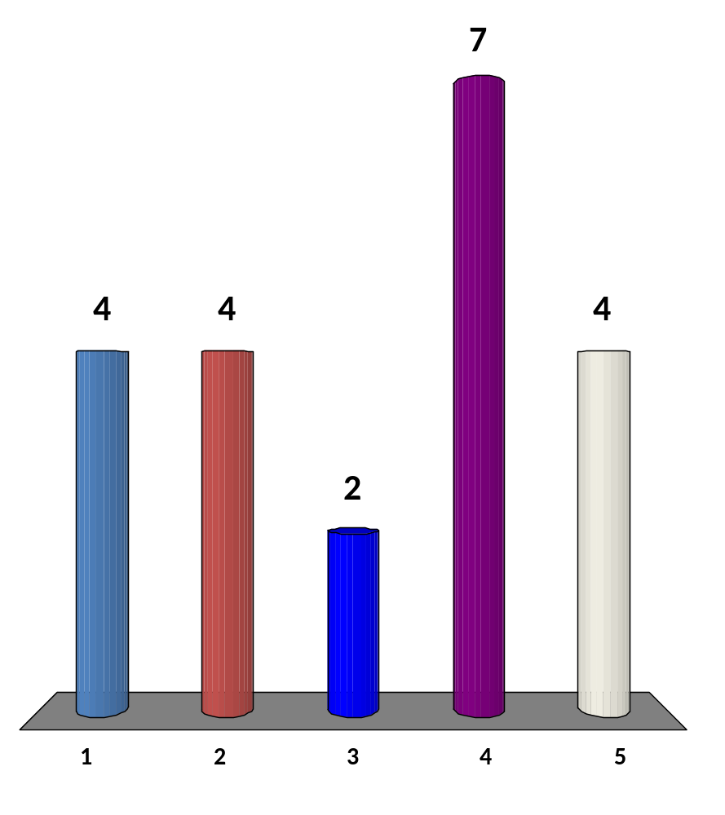
Are you a video gamer?
No, I do not play video game :O
Yes, but I only play a new video game maybe once a year
(or very rare)
Yes, I play a new video game once a month (or very often)
Yes, I play a new video game every time a new game type that I like is released
Not only that, I am also learning how to build my own game here in SoC ☺
20 of 120
CS3233 - Competitive Programming,
Steven Halim, SoC, NUS

Slide 5
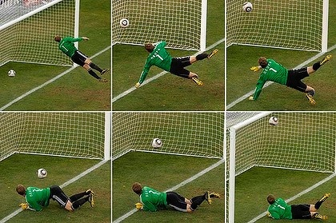
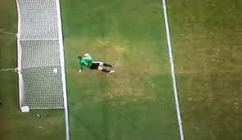
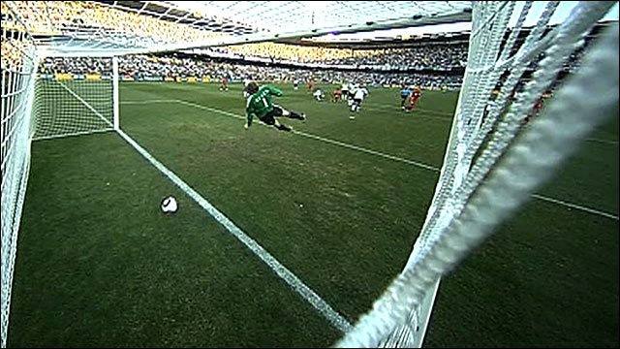
CS3233 - Competitive Programming,
Steven Halim, SoC, NUS

Slide 6
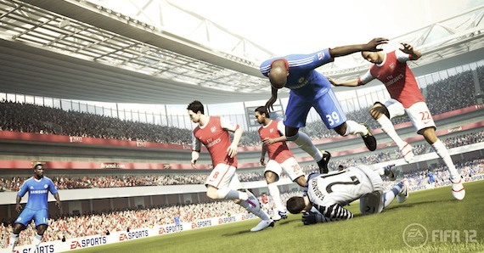
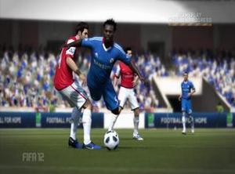
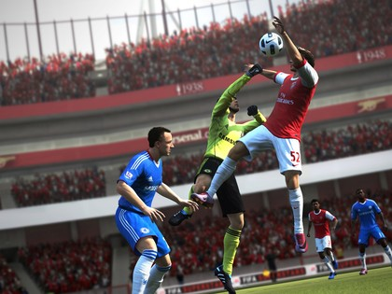
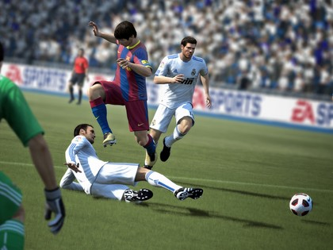
CS3233 - Competitive Programming,
Steven Halim, SoC, NUS

Slide 7
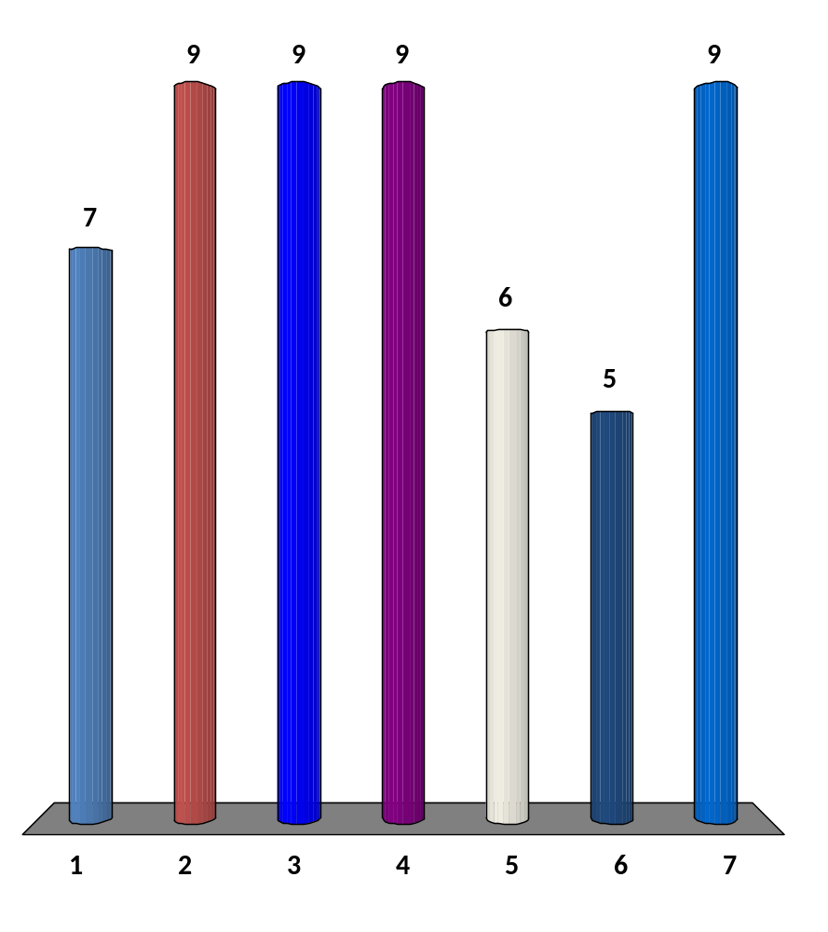
Before this lecture, I can
(select all that are applicable)
Rotate a point around origin by certain angle
Check if a point is on the left or right side of a line
Compute the Euclidian distance between two points
Check if two lines are parallel
Check if two lines intersect, and if they are, compute the point of intersection
Compute the shortest distance from a point to a line
I can do all the above + more ☺
17 of 120
CS3233 - Competitive Programming,
Steven Halim, SoC, NUS

Slide 8
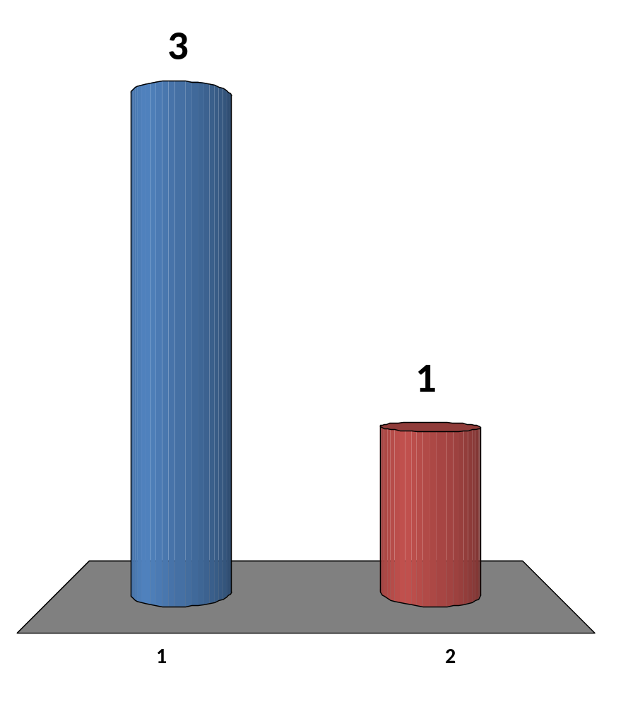
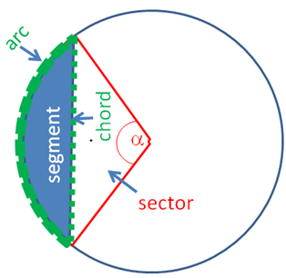
What is the chord length of a circle with radius r and angle α?
I know, it is _____
(I will write this formula
in the whiteboard)
Err… I don’t know/forgot
4 of 120
CS3233 - Competitive Programming,
Steven Halim, SoC, NUS

Slide 9
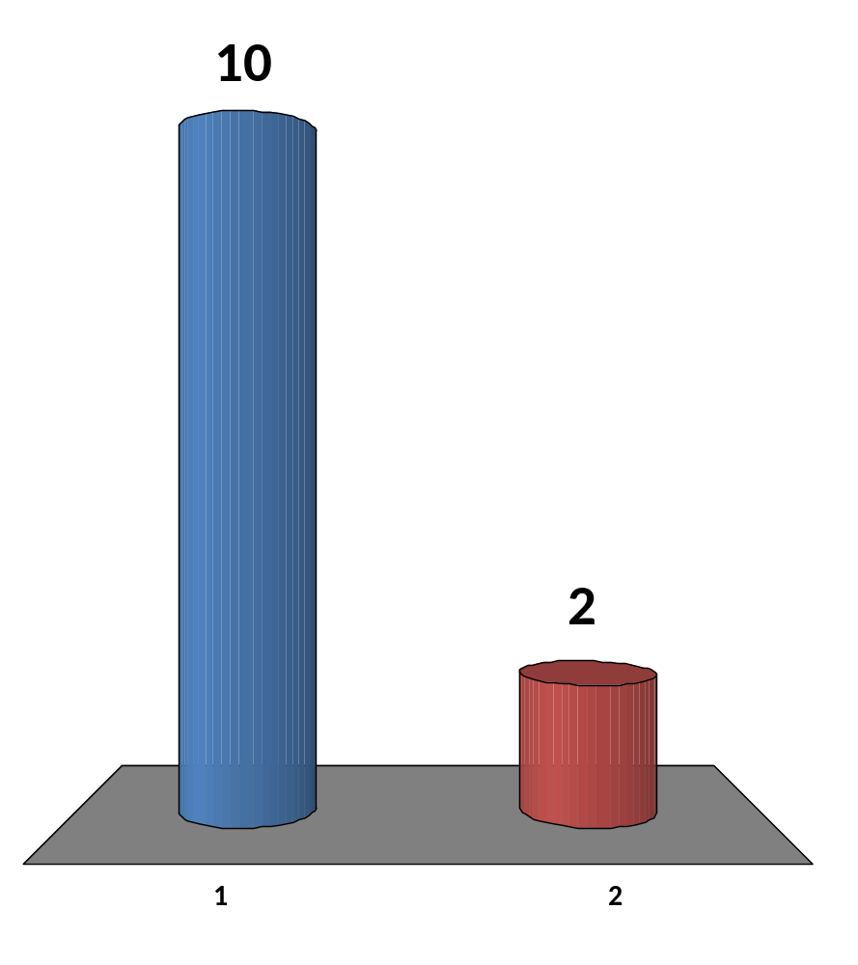
What is radius r?
You are given the coordinates of p, q, and r
I know, it is _____
(I will write this formula
in the whiteboard)
Err… I don’t know/forgot
r
r
c1
q
p
12 of 120
CS3233 - Competitive Programming,
Steven Halim, SoC, NUS
Notes:
r = A / s

Slide 10
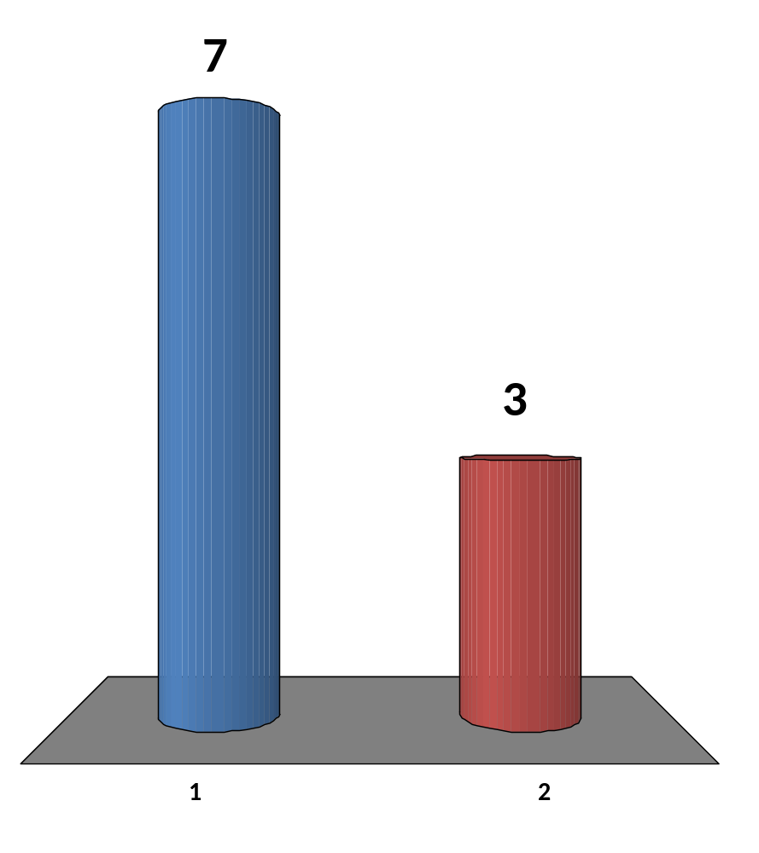
What is radius R?
You are given the coordinates of p, q, and r
I know, it is _____
(I will write this formula
in the whiteboard)
Err… I don’t know/forgot
r
c2
R
q
p
10 of 120
CS3233 - Competitive Programming,
Steven Halim, SoC, NUS
Notes:
R = a x b x c / (4 * A)

Slide 11
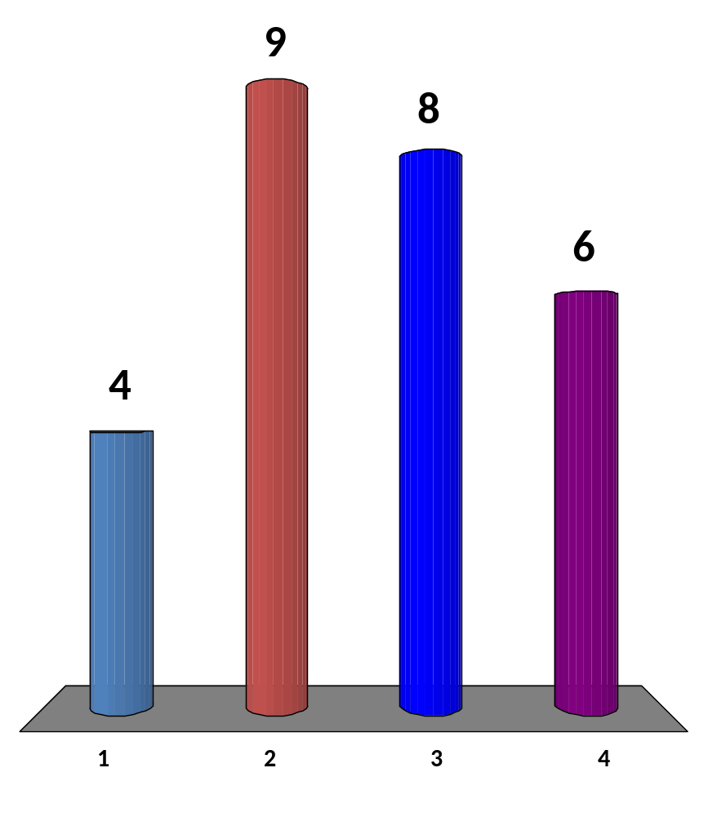
The Algorithms on Polygon so Far…
(click all that is true for you)
Scary
Cool
Can’t possibly remember all those codes, must bring hardcopy to next week’s contest
Show me some applications!
16 of 120
CS3233 - Competitive Programming,
Steven Halim, SoC, NUS
Notes:
R = a x b x c / (4 * A)

Slide 12
UVa Problem Discussions
UVa 10078 – Art Gallery
  “Easy” with isConvex
UVa 11265 – The Sultan’s Problem
  “Easy” with cutPolygon, inPolygon, area
CS3233 - Competitive Programming,
Steven Halim, SoC, NUS

Slide 13
HW10 (due next Wed 11.59am!)
  Go to: http://uhunt.felix-halim.net/id/32900
  Solve UVa 11265 – The Sultan’s Problem by using cutPolygon, inPolygon, area
  If you have solved these problems in the past, fine, we will count it as “homework part A done”
Solve problem C (K-th Substring) from today
  EMAIL to Harta directly: harta.wijaya.11.10@gmail.com
Write a report on Chapter 7 (all… you will need some time to read it :O)
  Upload to IVLE Workbin, “CP2 Review”
Potential Achievements
  Chapter 6 diversity: Solve four starred problems from different category in chapter 6 by the end of Week11
  Chapter 7 diversity: Solve four starred problems from different category in chapter 7 by the end of Week12
  Chapter 8 diversity: Solve four starred problems from different category in chapter 8 by the end of Week13

